Slide 1




The institutional logic behind illicit behavior
Informal property rights as the determinant of the expansion of coca crops in Colombia
By Jesse d’Anjou (ULB, TAMNEAC)
Joint work with Santiago Tobón-Zapata (UCL), Juan Carlos Muñoz-Mora (ULB, TAMNEAC)

Slide 2
Motivation
Development of institutions( Acemoglu, Johnson, & Robinson, 2001, 2005; Acemoglu & Robinson, 2010, 2012; Acemoglu & Verdier, 1998; North, 1981; Jones, 1987; Engerman and Sokoloff, 2008)
Influenced by many factors (e.g. historical, political, economical)
Incremental change of institutions
Direct and indirect effects (Acemoglu, Johnson, & Robinson, 2001, 2005; Acemoglu & Robinson, 2010, 2012; Acemoglu & Verdier, 1998; Besley, 1995; Besley & Ghatak, 2010; De Soto, 2000; Easterly & Levine, 2003; Hall & Jones, 1999; Pande & Udry, 2006)
Positive (e.g. productivity, income-growth, transaction cost, investment
Negative (informal markets, disinvestment, illicit behavior?)
No clear understanding of a given institutional regime, and illicit behavior
Effects persistency of weak institutions

Slide 3
Research question
Informal property rights → negative effect on presence of coca crop plantations?
Rent-seeking (e.g. conflict, power over resources)
Law enforcement
Risk taking behavior
Higher potential income of households (Risk influenced profits)
Contribution:
Take institutions as a given, and analyze to what extent this effects on illegal activity (e.g. coca crop production
Policy implication
Formalization programmes evidence-based policy?
Economic Institutions as important determinants of illicit behavior?
Panel data on municipality level from Colombia

Slide 4
Contents
Literature
Colombia
Empirical evidence
Data
Methodology
Estimation
Results
Conclusion and implications
Discussion points

Slide 5
Literature I
Property rights important factor in general institutional framework (North, 1981)
Property rights
Strong →
Boost wages, productivity, investment, innovation, etc. (Besley, 1995; Besley & Burgess, 2000; Deininger, Ali, & Yamano, 2008; Deininger & Jin, 2006; Goldstein and Udry, 2008; Acemoglu & Robinson, 2012; Demsetz, 1967)
Behavior blocked by inability or unwillingness of the ones in power (Acemoglu, Ticchi, & Vindigni, 2011).
Weak →
Market distortions, political institutions, hinder law enforcement, social tensions, etc. (e.g. potentially facilitating violence)(Richards, 1998; Collier, Hoeffler & Söderdom, 2004; Collier & Hoeffler, 2004; Ross, 2004)
In development countries, land most valued and contested property (Acemoglu, Johnson, & Robinson, 2001; Baland & Robinson, 2008; Dercon & Krishnan, 2010).

Slide 6
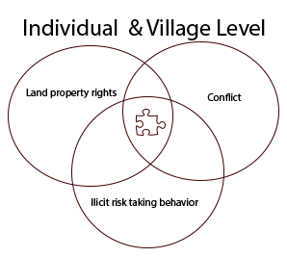
Literature II
Frameworks (correlated)
Institutional setting → effects (political economy) (Acemoglu, 2006; Fergusson, 2012; Acemoglu and Robinson, 2012; Andre & Platteau, 1998; Deininger, 2003; Deininger & Nagarajan, 2009; Binswanger, Deininger, & Feder, 1995)
Decision making process (Dercon and Ayalew, 1995; Dercon & Krishnan, 2010)
Evidential consequences: risk taking behavior, conflict, attractive to rent seeking, resources expropriation.

Slide 7
Colombia
Presence of formal and informal land property rights (i.e. large variation between village) (Acemoglu and Robinson, 2012)
Regions where 60% of the land area is without legal titles whereas others have full coverage (Ibañez & Muñoz-Mora, 2011; Fernandez, 2010)
Armed conflict fueled by coca ( Guerillas, cartels and paramilitaries!)
Coca growing regions higher self-employment income, homicide rates, child labor, and negative effect on schooling (Angrist & Kugler, 2008; Dávalos et al., 2011; Mejía & Rico, 2010; Dammert, 2008; Moreno-Sanchez et al.,2003; Ibanez and Carlsson (2010)).
Colombia currently among the main coca producing and exporting counties (coca easy to crop and large profits. )
Counter-policies have mainly focused on destroying production lines trade (Limited success)
New policies focus on promoting legal alternatives (e.g. Technical assistance, Agricultural loans, more level of enforcement).
No clear scientific evidence on the link of formalization programs in the war on drugs.

Slide 8
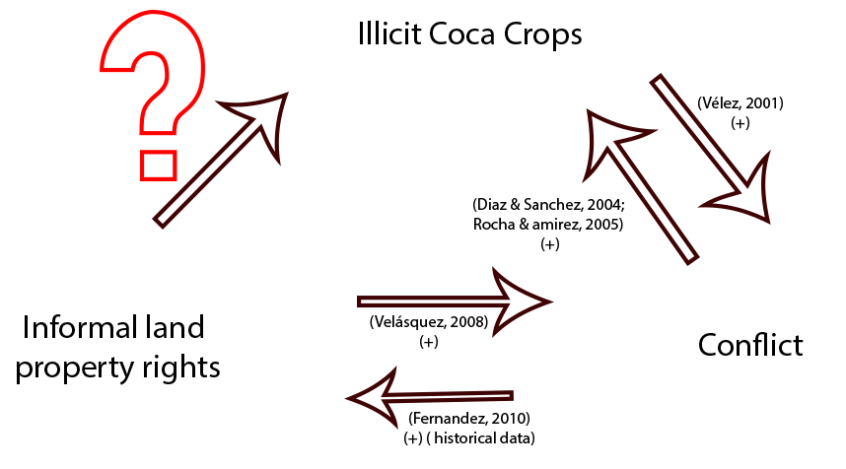
Empirical Evidence
Causalities run in all directions, with no study given a clear view due to the estimations

Slide 9
Data
2000-2009 Longitudinal on municipality level
Presence of coca fields (UNODC) (Satellite identification)
Informality index proposed by Ibánez and Muñoz-Mora (2011).
Only titling, not ability to exercise
Cadastral database of the Geographical Institute Agustn Codazzi
Municipal development index as Robustness check (Acemoglu et al., 2005)
Violence: homicide rate per 100.000 inhabitants per municipality
Other Controls
Geographic: time-invariant (e.g. altitude, distance to nearest market)
Political (e.g. expenditures on education, health, etc,)
Land (e.g. land quality gini index)
Socio-economic (e.g. health coverage)

Slide 10
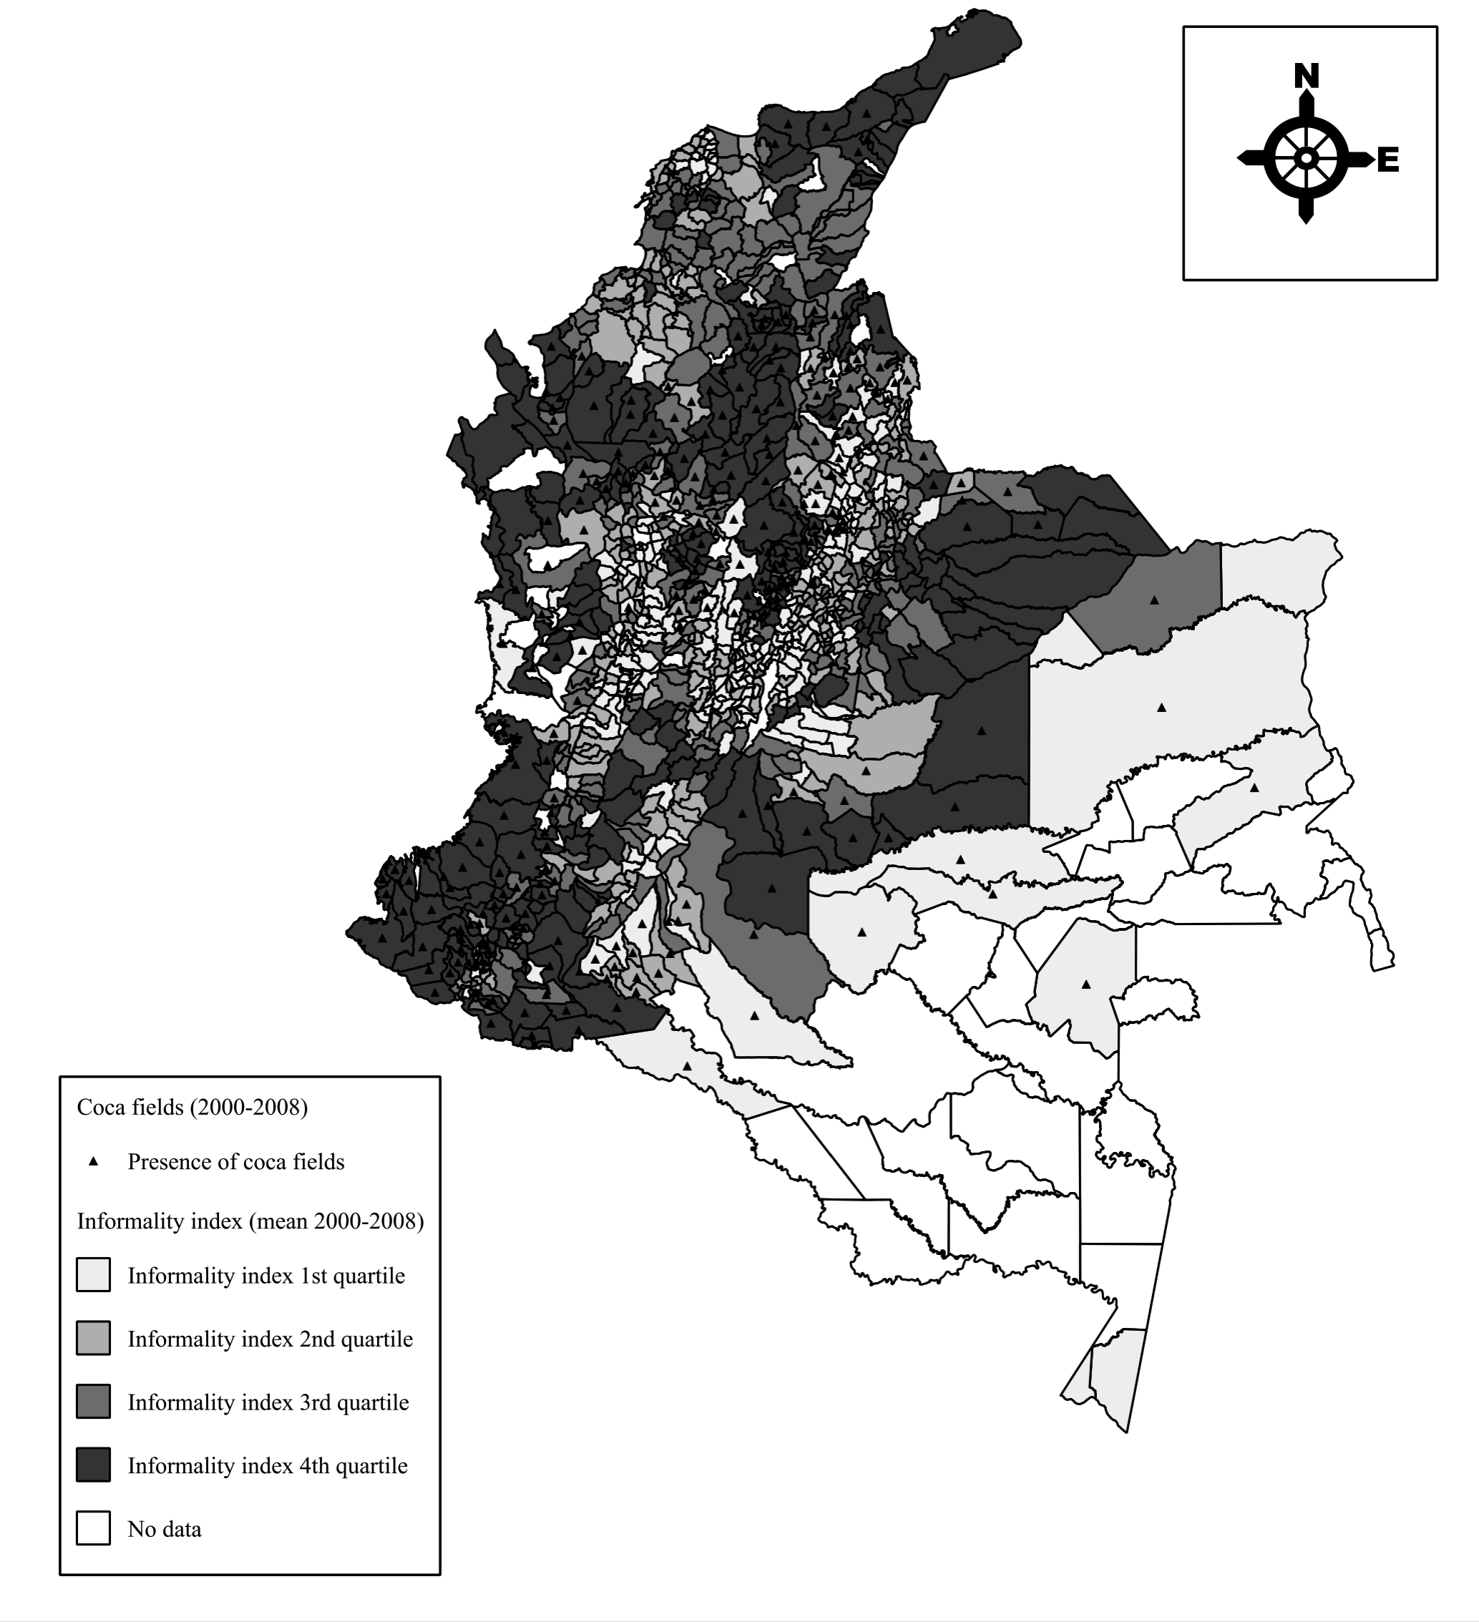

Slide 11
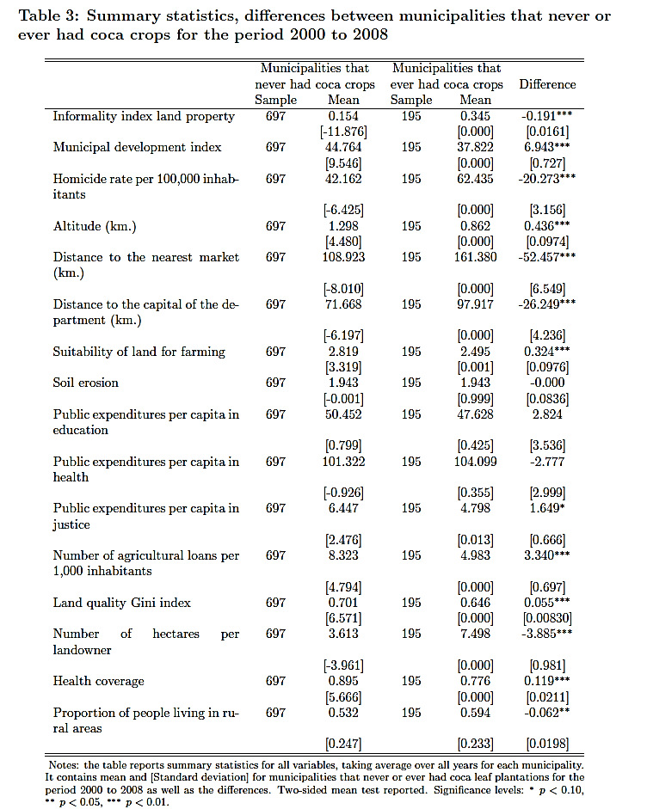
Results

Slide 12
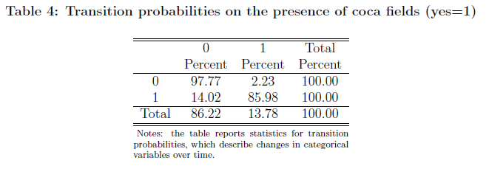
Data

Slide 13
Methodology
High persistency over time
Institutions (property rights not volatile economic institution)
Presence of coca crops
→ Limited variance in these variables +correlated
Large heterogeneity between municipalities
Data big N, small T
OLS biased and inconsistent
Dynamic specification (Arellano and Bond, 1991; Blundell and Bond, 1998).
Therefore, system GMM (Blundell & Bond, 1998; Blundell, Bond, & Windmeijer, 2000)
Lags of endogenous variables as instruments
Potential weakness: many instruments (weak instruments and validation), downward bias standard error (i.e. residual bias) (Christiaensen, Demery, & Kuhl, 2011; Heid, Langer, & Larch, 2012; Beck & Levine, 2004; Roodman, 2009).
Identify the causality linkage between the presence of illicit coca plantations and the informality index of property rights (C. W. J. Granger, 1969; C. W. Granger, 2003; Holtz-Eakin, Newey, & Rosen, 1988).

Slide 14
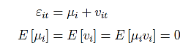
Estimation
i = municipality
t = year
y = coca crop presence
p = informality index
h = homicide rate
Where,

Slide 15
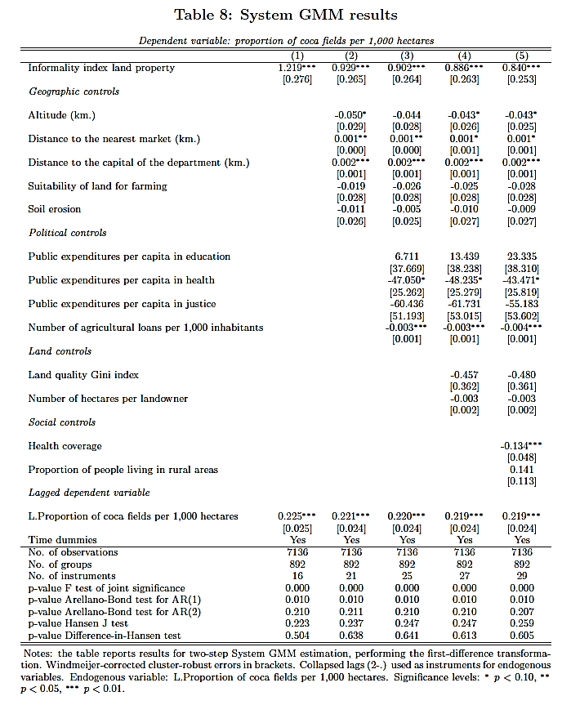

Slide 16
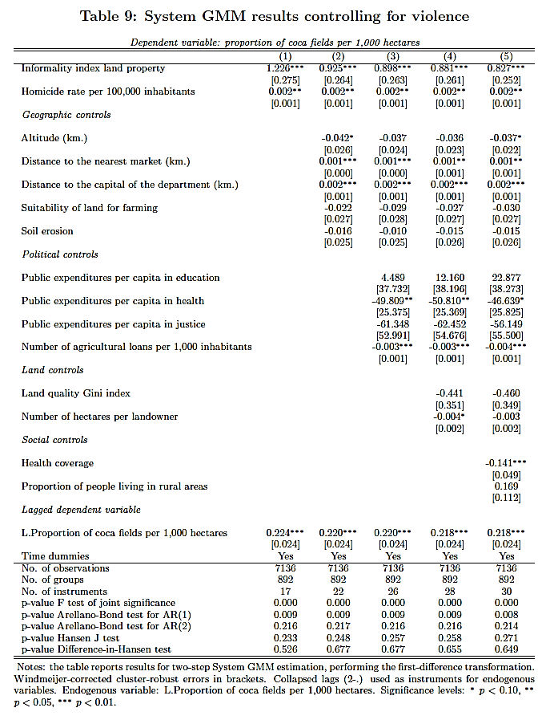

Slide 17
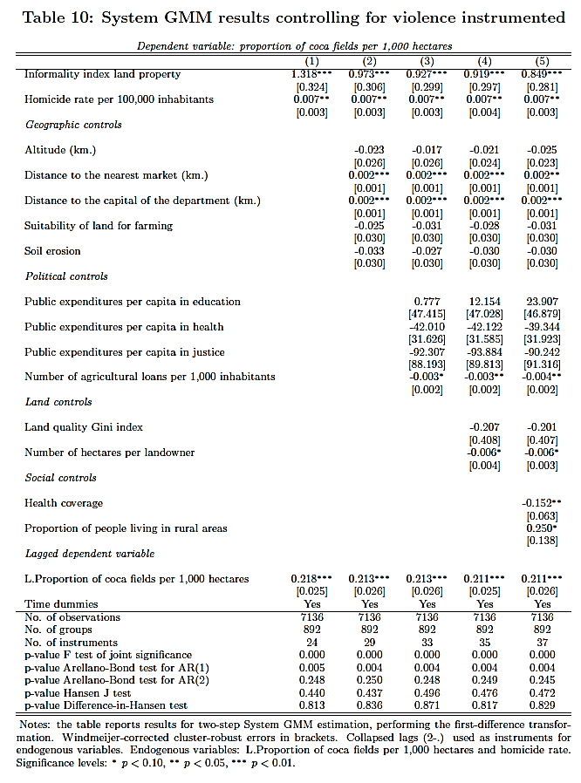

Slide 18
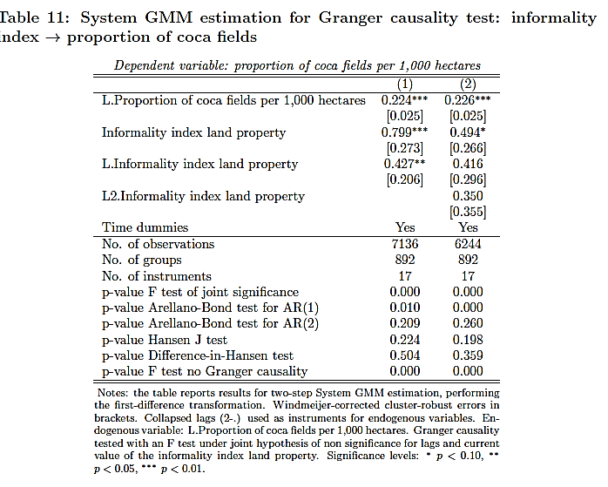

Slide 19
Robustness Check
Granger test other direction false
Falsification test
We use an alternative independent variable ( Municipality development Index).
Better institutions = less coca crops
Sample test
Only municipalities at 1500 mts (altitud) (geographically bias)
Similar results
Departments in which at least one municipality ever had coca. ( spillover bias).
Similar results

Slide 20
Conclusion and implications
Positive effect weaker property rights → coca crop plantations
Robust to different specifications, alternative measures for institutions, distinct subsamples, overidentication and serial correlation tests.
Reverse causality relationship “Granger-rejected”
Counter narcotic policies should also focus on formalization of property
Limit extension coca crop plantations
Plus possible gains in economic performance (e.g. productivity, investment)
Influence illicit groups
Could be difficult to implement in regions without clear law and order
Further research
Mechanisms behind this effect (macro and micro perspective)
Different formalization programmes

Slide 21
Discussion points
Theoretical model
Difficulties with empirical testing possibilities
From which perspective?
Household behavior
Political economy
Is literature enough?
Improvements
Linkage with mechanisms and our findings
Extra robustness checks ( endogeneity – persistency)
On the estimation strategy
Explaining system GMM assumptions
Persistence
Large N, small T
Two lags in matrix instead of four

Slide 22
Thank you

Slide 23
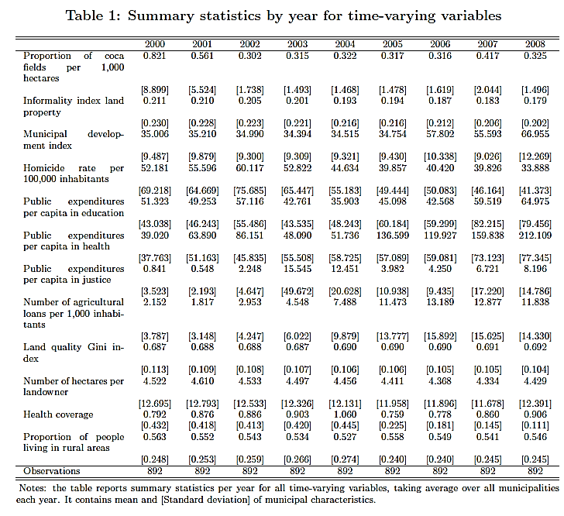
Results
Descriptives

Slide 24
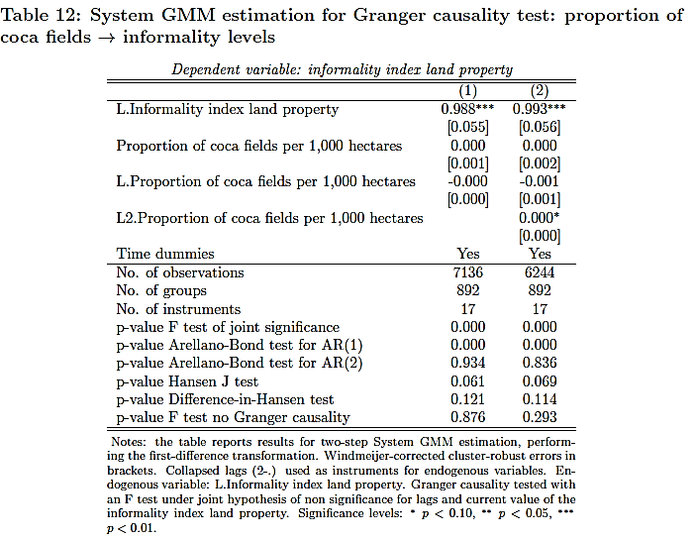

Slide 25
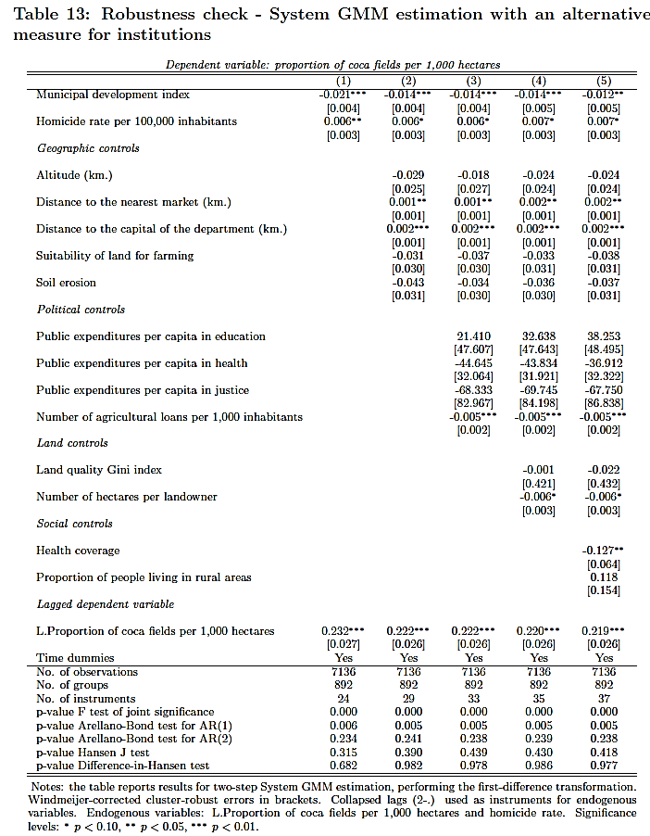

Slide 26
